Slide 1
BOSTON CLIMATE ACTION
Decarbonization pathways, policies, and programs
Notes:
Notes on the issues Raab asked us to cover:
1 - Wedge graph of what it takes to get to neutrality in boston
2- New Initiatives / Major Levers (will focus on CCE and Emissions Performance Standard)
3 - Innovative ways we’re including equity and EJ
4- Where we need State/Fed help (focus on ZNC building code)

Slide 2
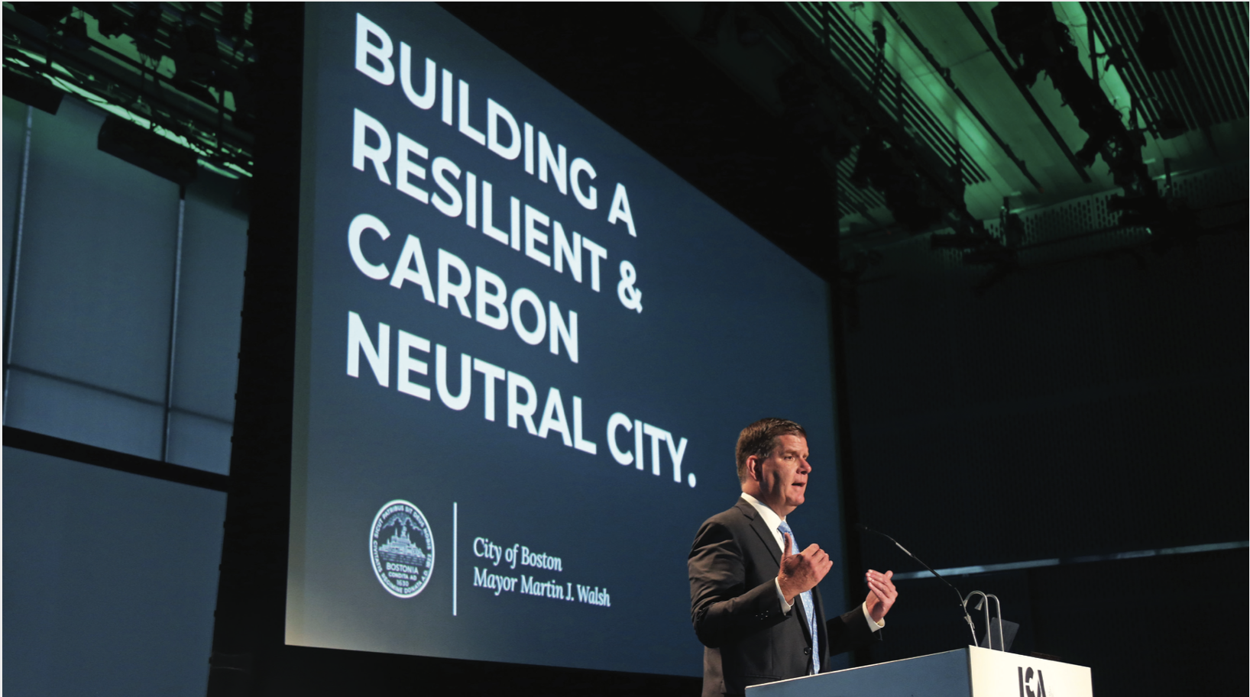

Slide 3
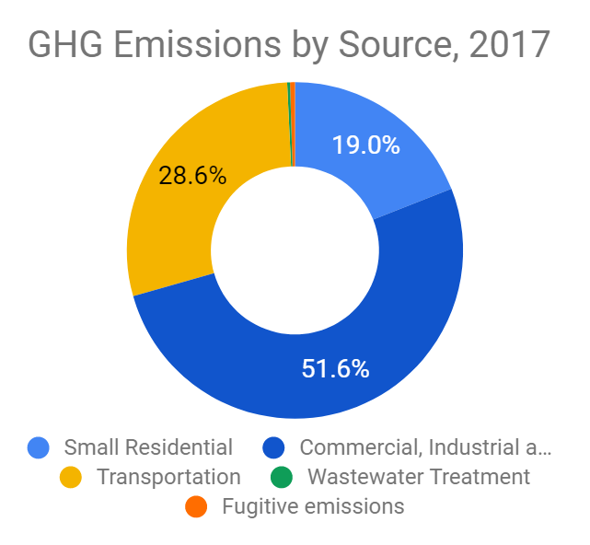
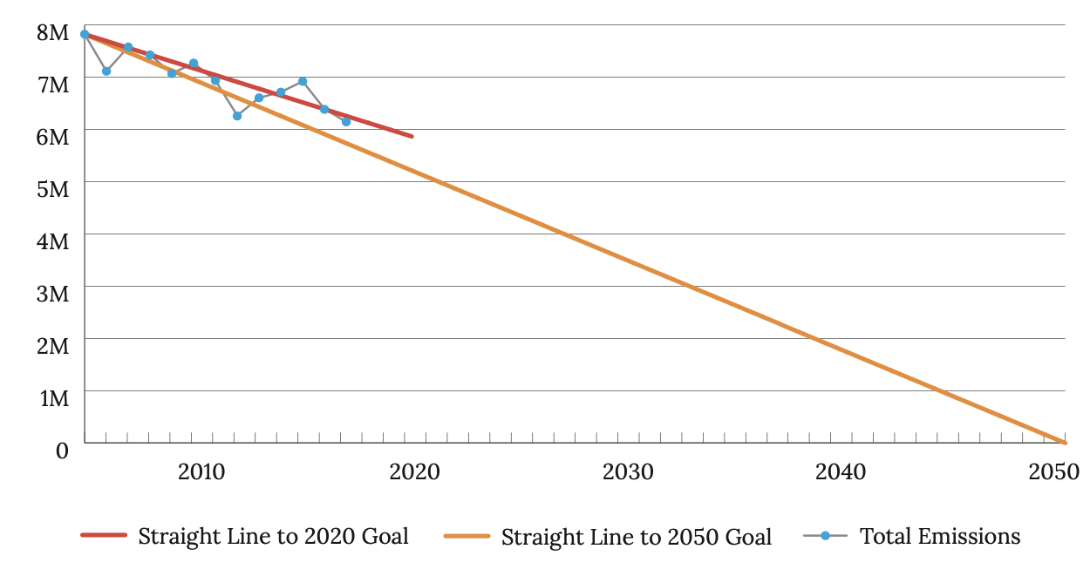
BOSTON’S CARBON FOOTPRINT

Slide 4
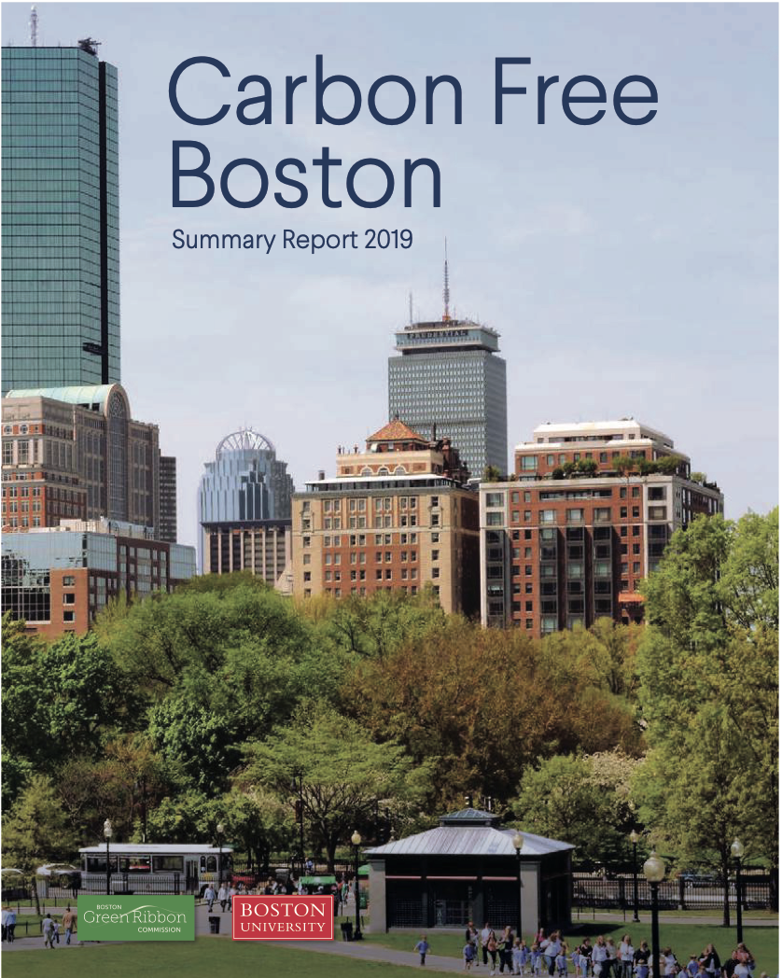
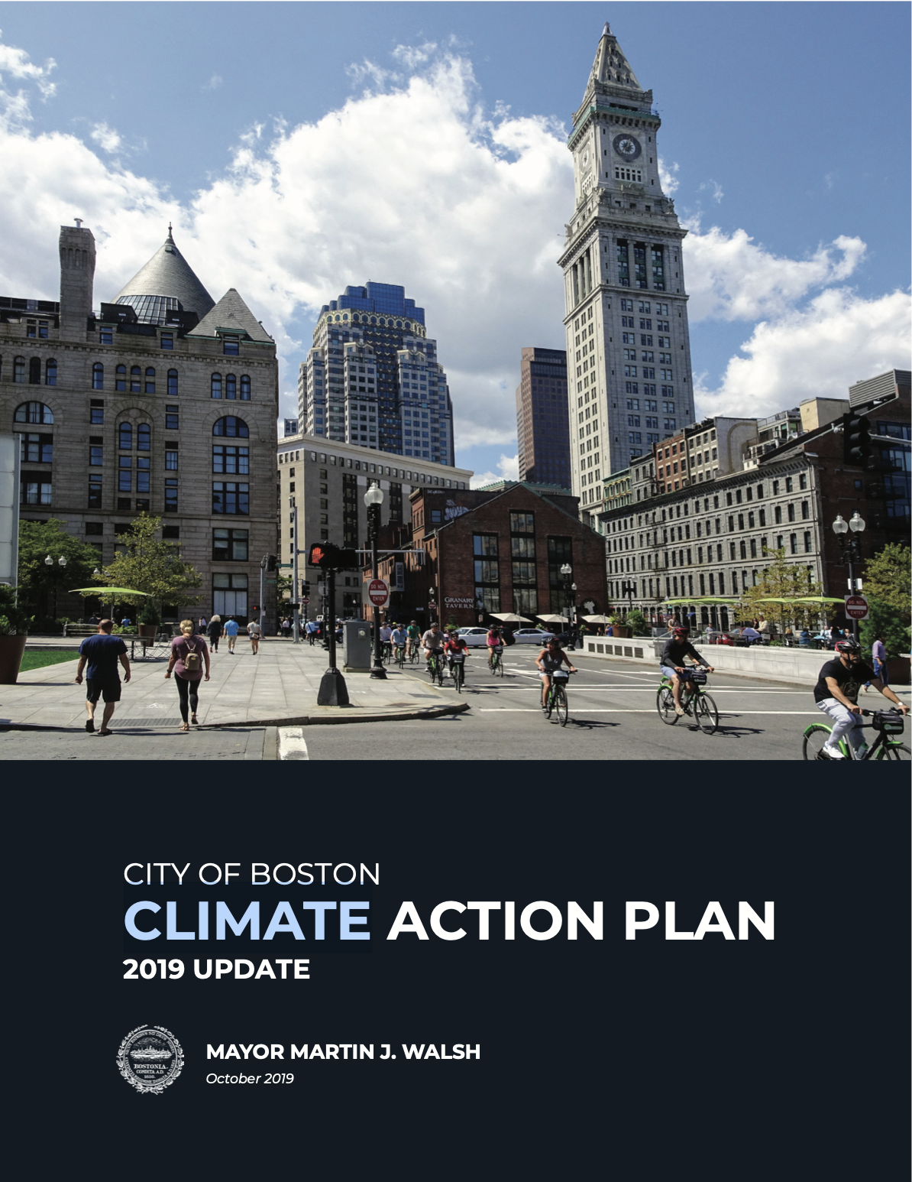
Understanding what it takes to get to carbon neutrality...
… and detailing how we’ll accelerate action in the next five years.
Chief Cook

Slide 5
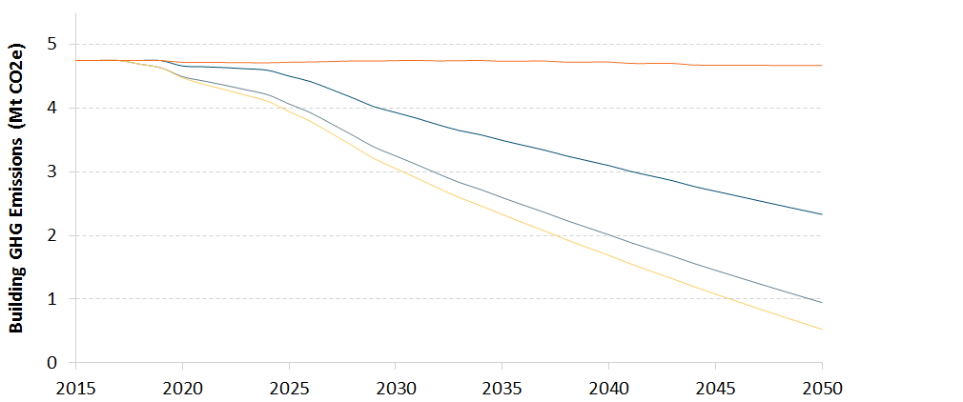
BUILDING SECTOR ANALYSIS
Decarbonization pathway
Potential path to 2050:
Baseline
Net Zero new construction,
deep energy retrofits, electrification,
solar roofs
The state reaches its 80% clean grid goal
Boston buys 100% clean electricity
Gap

Slide 6
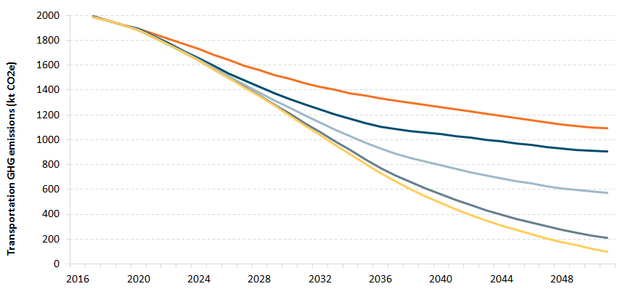
TRANSPORTATION SECTOR ANALYSIS
Decarbonization pathway
Potential path to 2050:
Go Boston 2030, travel pricing, ride-sharing fees
Electric vehicles are more efficient
The state reaches its 80% clean grid goal
Boston buys 100% clean electricity

Slide 7
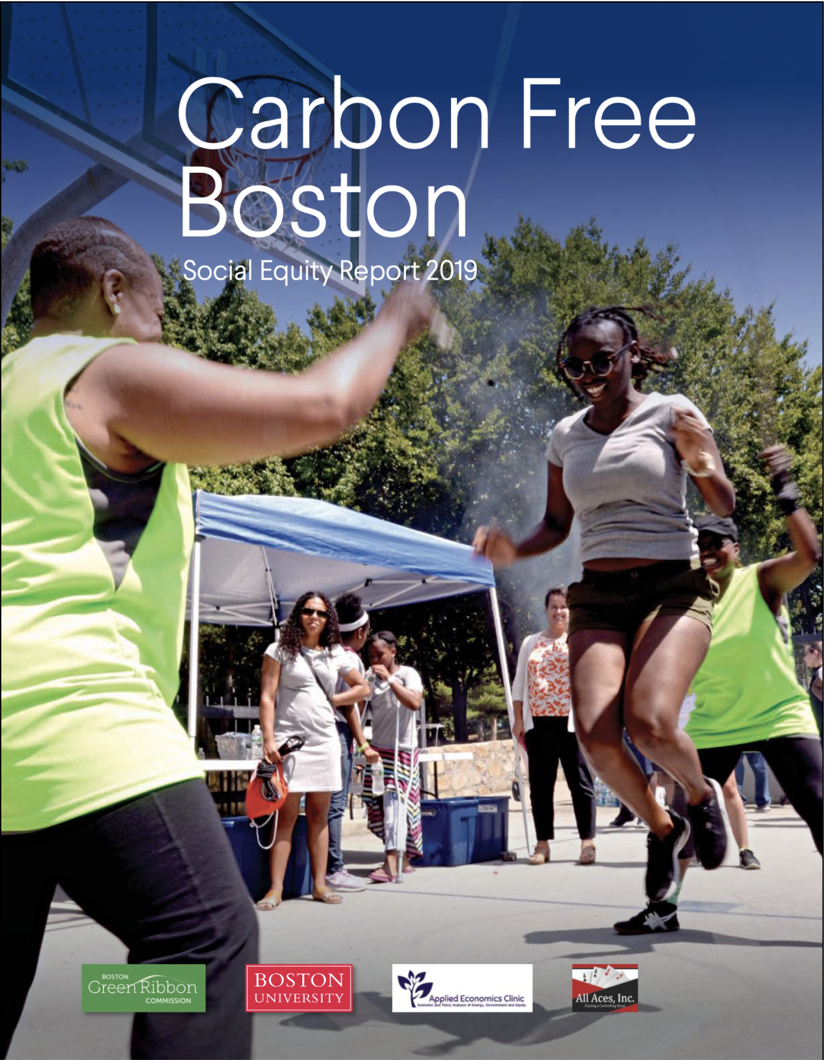
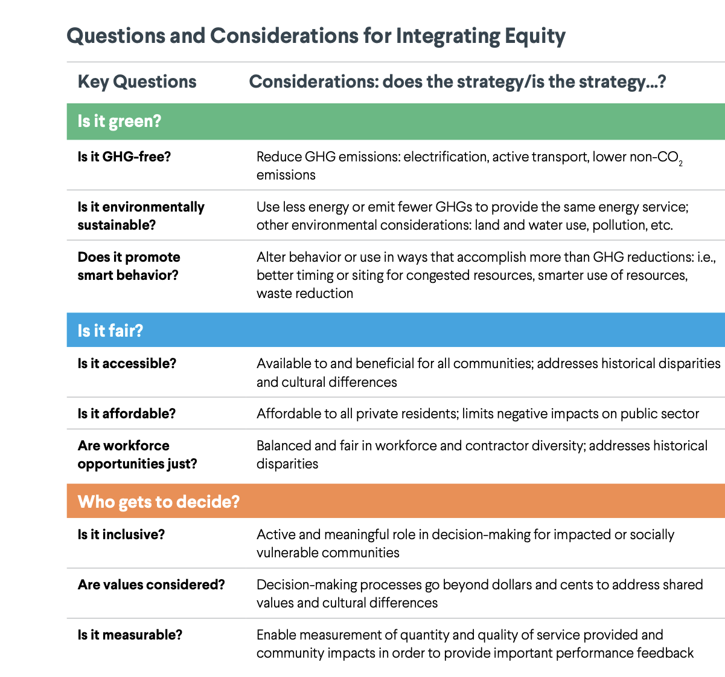
Chief Cook
Notes:
EJ in CFB and how that was reflected in the CAP process

Slide 8
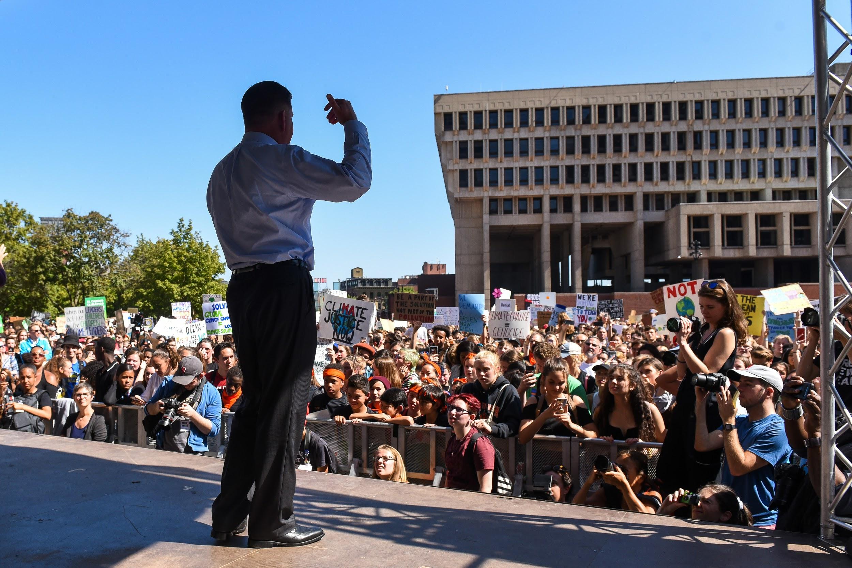
Notes:
Transition slide to start talking about major projects and initiatives in the CAP.

Slide 9
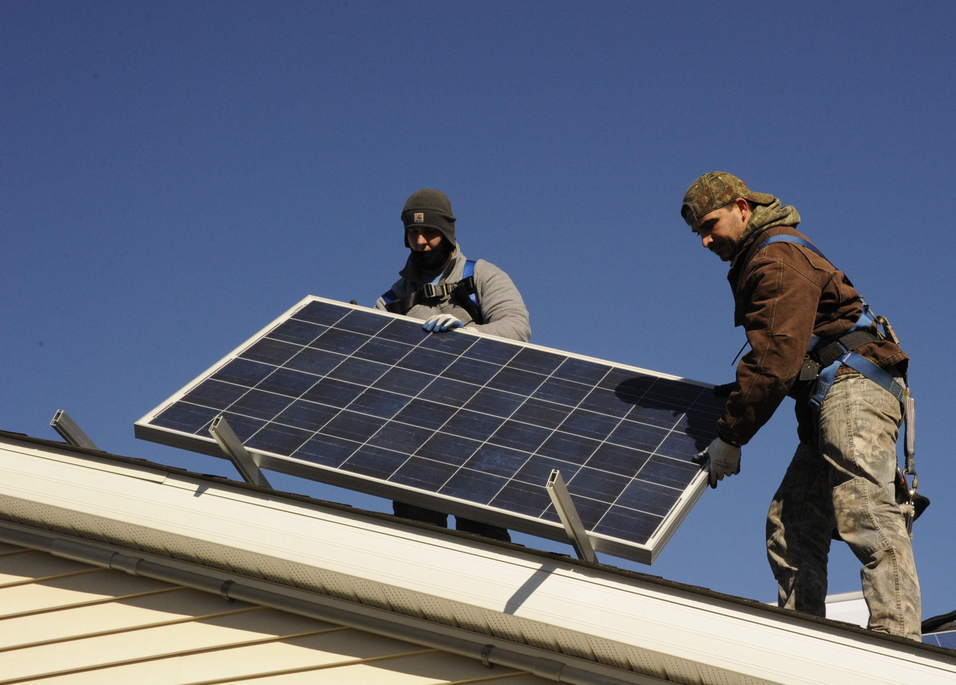

CITY OF BOSTON’S COMMUNITY CHOICE ELECTRICITY
Guiding principles:
strengthen consumer protection
offer affordable and stable electric rates
reduce carbon emissions
increase the share of renewable energy on the grid
support local renewable energy, and
commit to environmental justice.
Notes:
These six guiding principles provide us a foundation to design and implement the program.
BCCE Working Group developed 6 principles and values

Slide 10
CITY OF BOSTON’S COMMUNITY CHOICE ELECTRICITY
JULY 2020
FEB. 2021
INCLUDES
GENERATE
Approved by the DPU
Targeted services February 2021
At least 250,000 households and businesses
More than 1.7 tWh annually
Chief Cook
RFP FOR ELECTRICITY AND RENEWABLES RELEASED THIS WEEK
Seeking bids for between 6 months and 3 years
Default product expected to be between 5% and 25% above RPS, depending on underlying power price and price for renewable attributes
For renewables above RPS, only seeking Massachusetts Class 1 RECs from sources which do not produce GHG emissions
Notes:
Suppliers to provide information on how they will help to meet P&Vs
Expect to begin the opt-out process at the end of November, and will announce product offerings prior to that

Slide 11
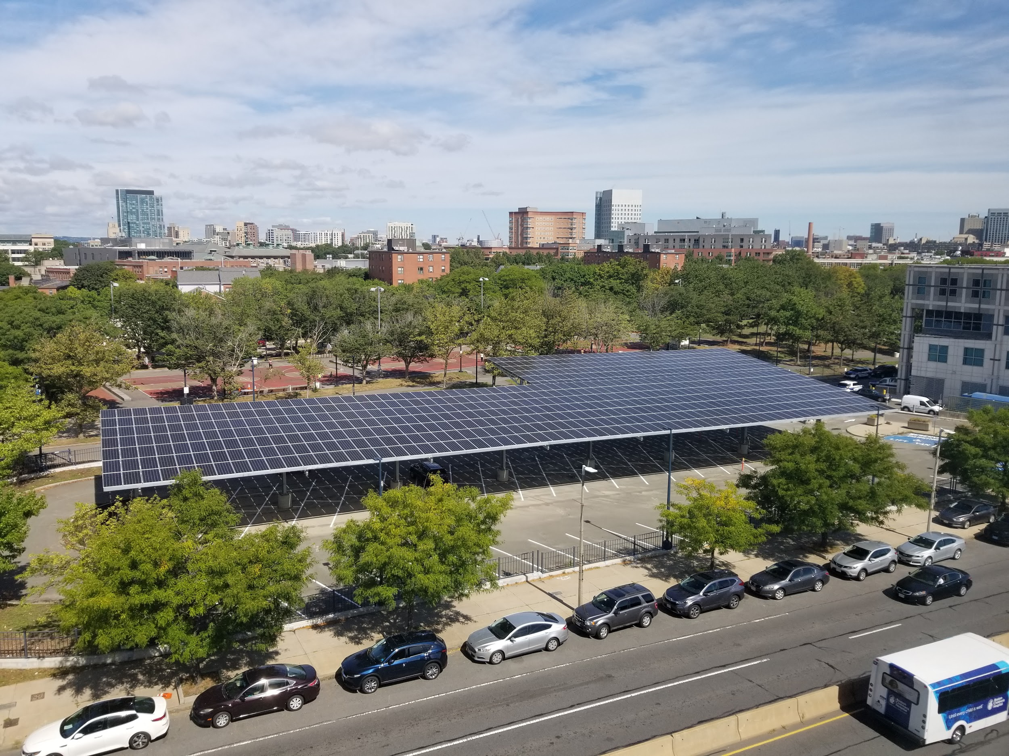
INVEST IN ENERGY EFFICIENCY AND RENEWABLE ENERGY
GENERATION IN MUNICIPAL BUILDINGS

Slide 12
Lead by Improving Municipal Buildings
Renew Boston Trust established to use Energy Performance Contracting to Improve City-owned buildings
Phase 1 - Completed efficiency work in 14 buildings
  $11 million with guaranteed annual electric savings of 2.6 million kWh and natural gas savings of 49,000 therms
Phase 2 starting on 31 buildings
  $18 million with guaranteed annual electric savings of 1.2 million kWh and natural gas of 63,000 therms
Beginning Audit work on Phase 3 - targeting 14 buildings, including 10 schools and a total of up to 30 solar installations
Expecting to release an RFQ for a Exterior Lighting Efficiency Project in early 2021

Slide 13
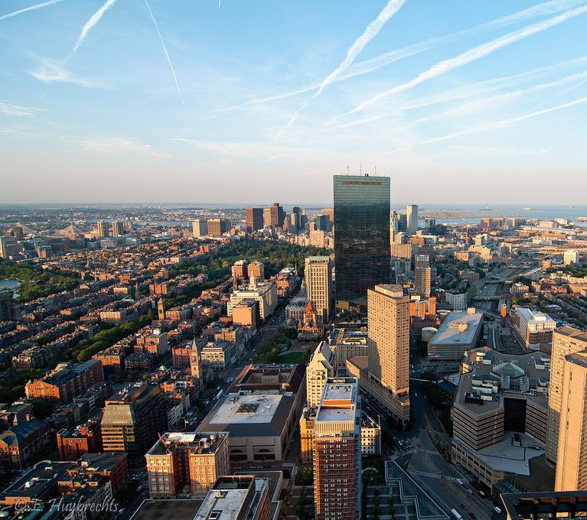
DEVELOP A CARBON EMISSIONS PERFORMANCE STANDARD
TO DECARBONIZE EXISTING LARGER BUILDINGS
Notes:
Discuss performance standard impact and where we are in the development process

Slide 14
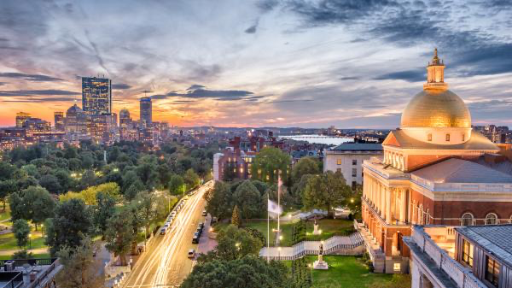
ADVOCATE FOR STATE BUILDING POLICIES THAT ALIGN
WITH CARBON NEUTRALITY BY 2050
SUPPORT STATE POLICIES AND PROGRAMS THAT FURTHER DECARBONIZE THE REGION'S AND BOSTON’S ENERGY SUPPLY
©iStockphoto.com/Sean Pavone
Chief Cook
Notes:
Discussion of items that we are dependent on the State
-- Focus on how critical the Net Zero Building Code Update is
-- Add in a plug for SCC in green communities / cost effectiveness test language if time

Slide 15
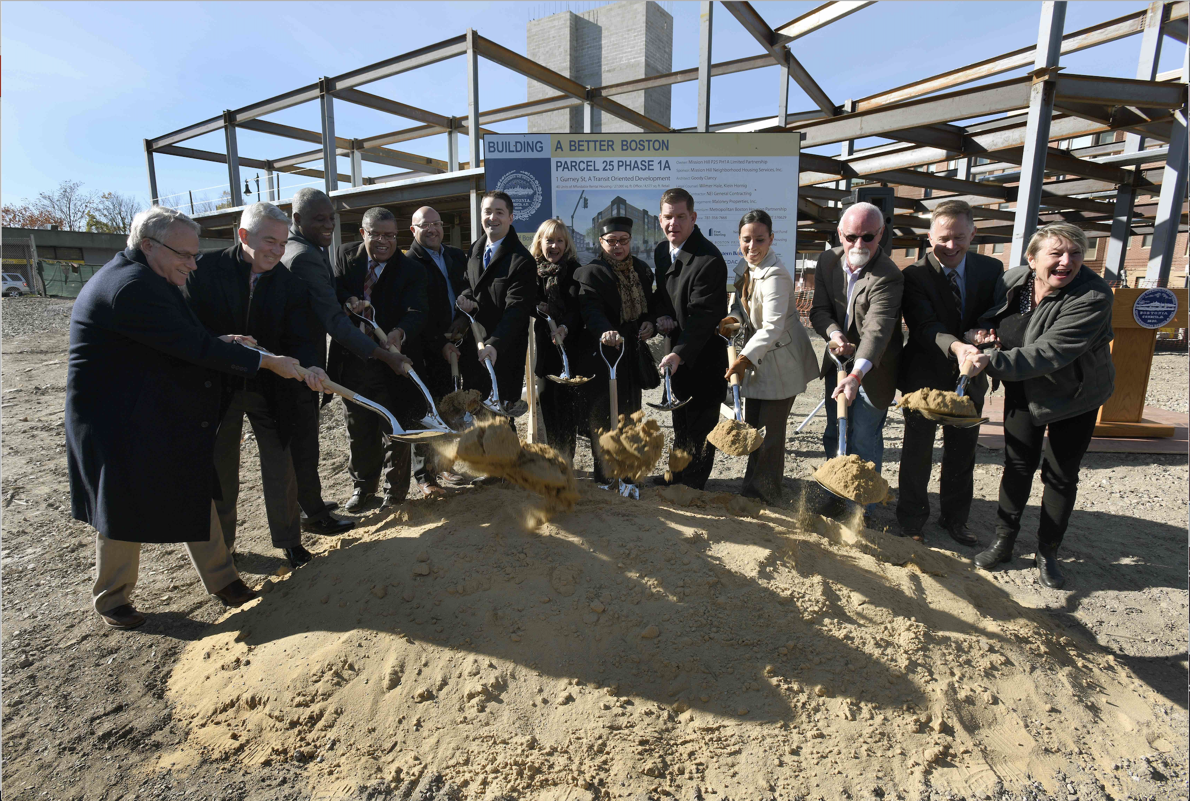
ADOPT A ZERO NET CARBON STANDARD
FOR CITY-FUNDED AFFORDABLE HOUSING
Notes:
Other pic optiosn:
https://www.flickr.com/photos/bosmayorsoffice/15719275995/
https://www.flickr.com/photos/bosmayorsoffice/30917324211/
https://www.flickr.com/photos/bosmayorsoffice/14897795822/

Slide 16
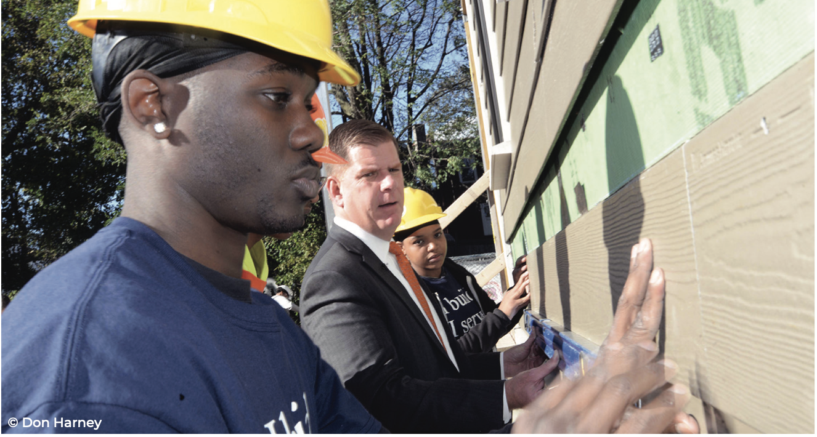
EXPAND WORKFORCE DEVELOPMENT PROGRAMS
FOR BUILDING DECARBONIZATION
Notes:
And investing in connecting residents with good jobs. Again it’s about how we combine our work to multiple the outcome-- RBT invests in Energy efficiency in city buildings and through projects like the contractor academy we are connecting MWDBE graduates with job opportunities and working to restructure our city contracts so they are more accessible to smaller contractors. etc.

Slide 17
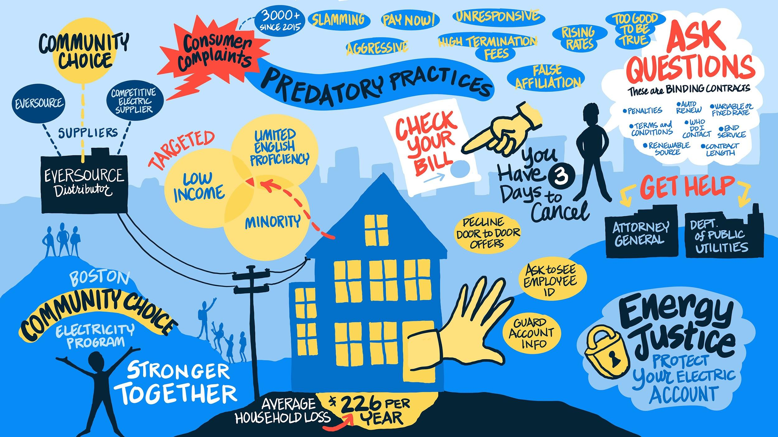
Chief Cook
Notes:
EJ in investment -- talk about CCE low income solar potential (if we can) or EJ priorities (if we cant)
And about equity in process and engagement
-- CCE initiatives, and community advisory board
-- Performance standard Residents advisory group participating in policy co-creation.

Slide 18
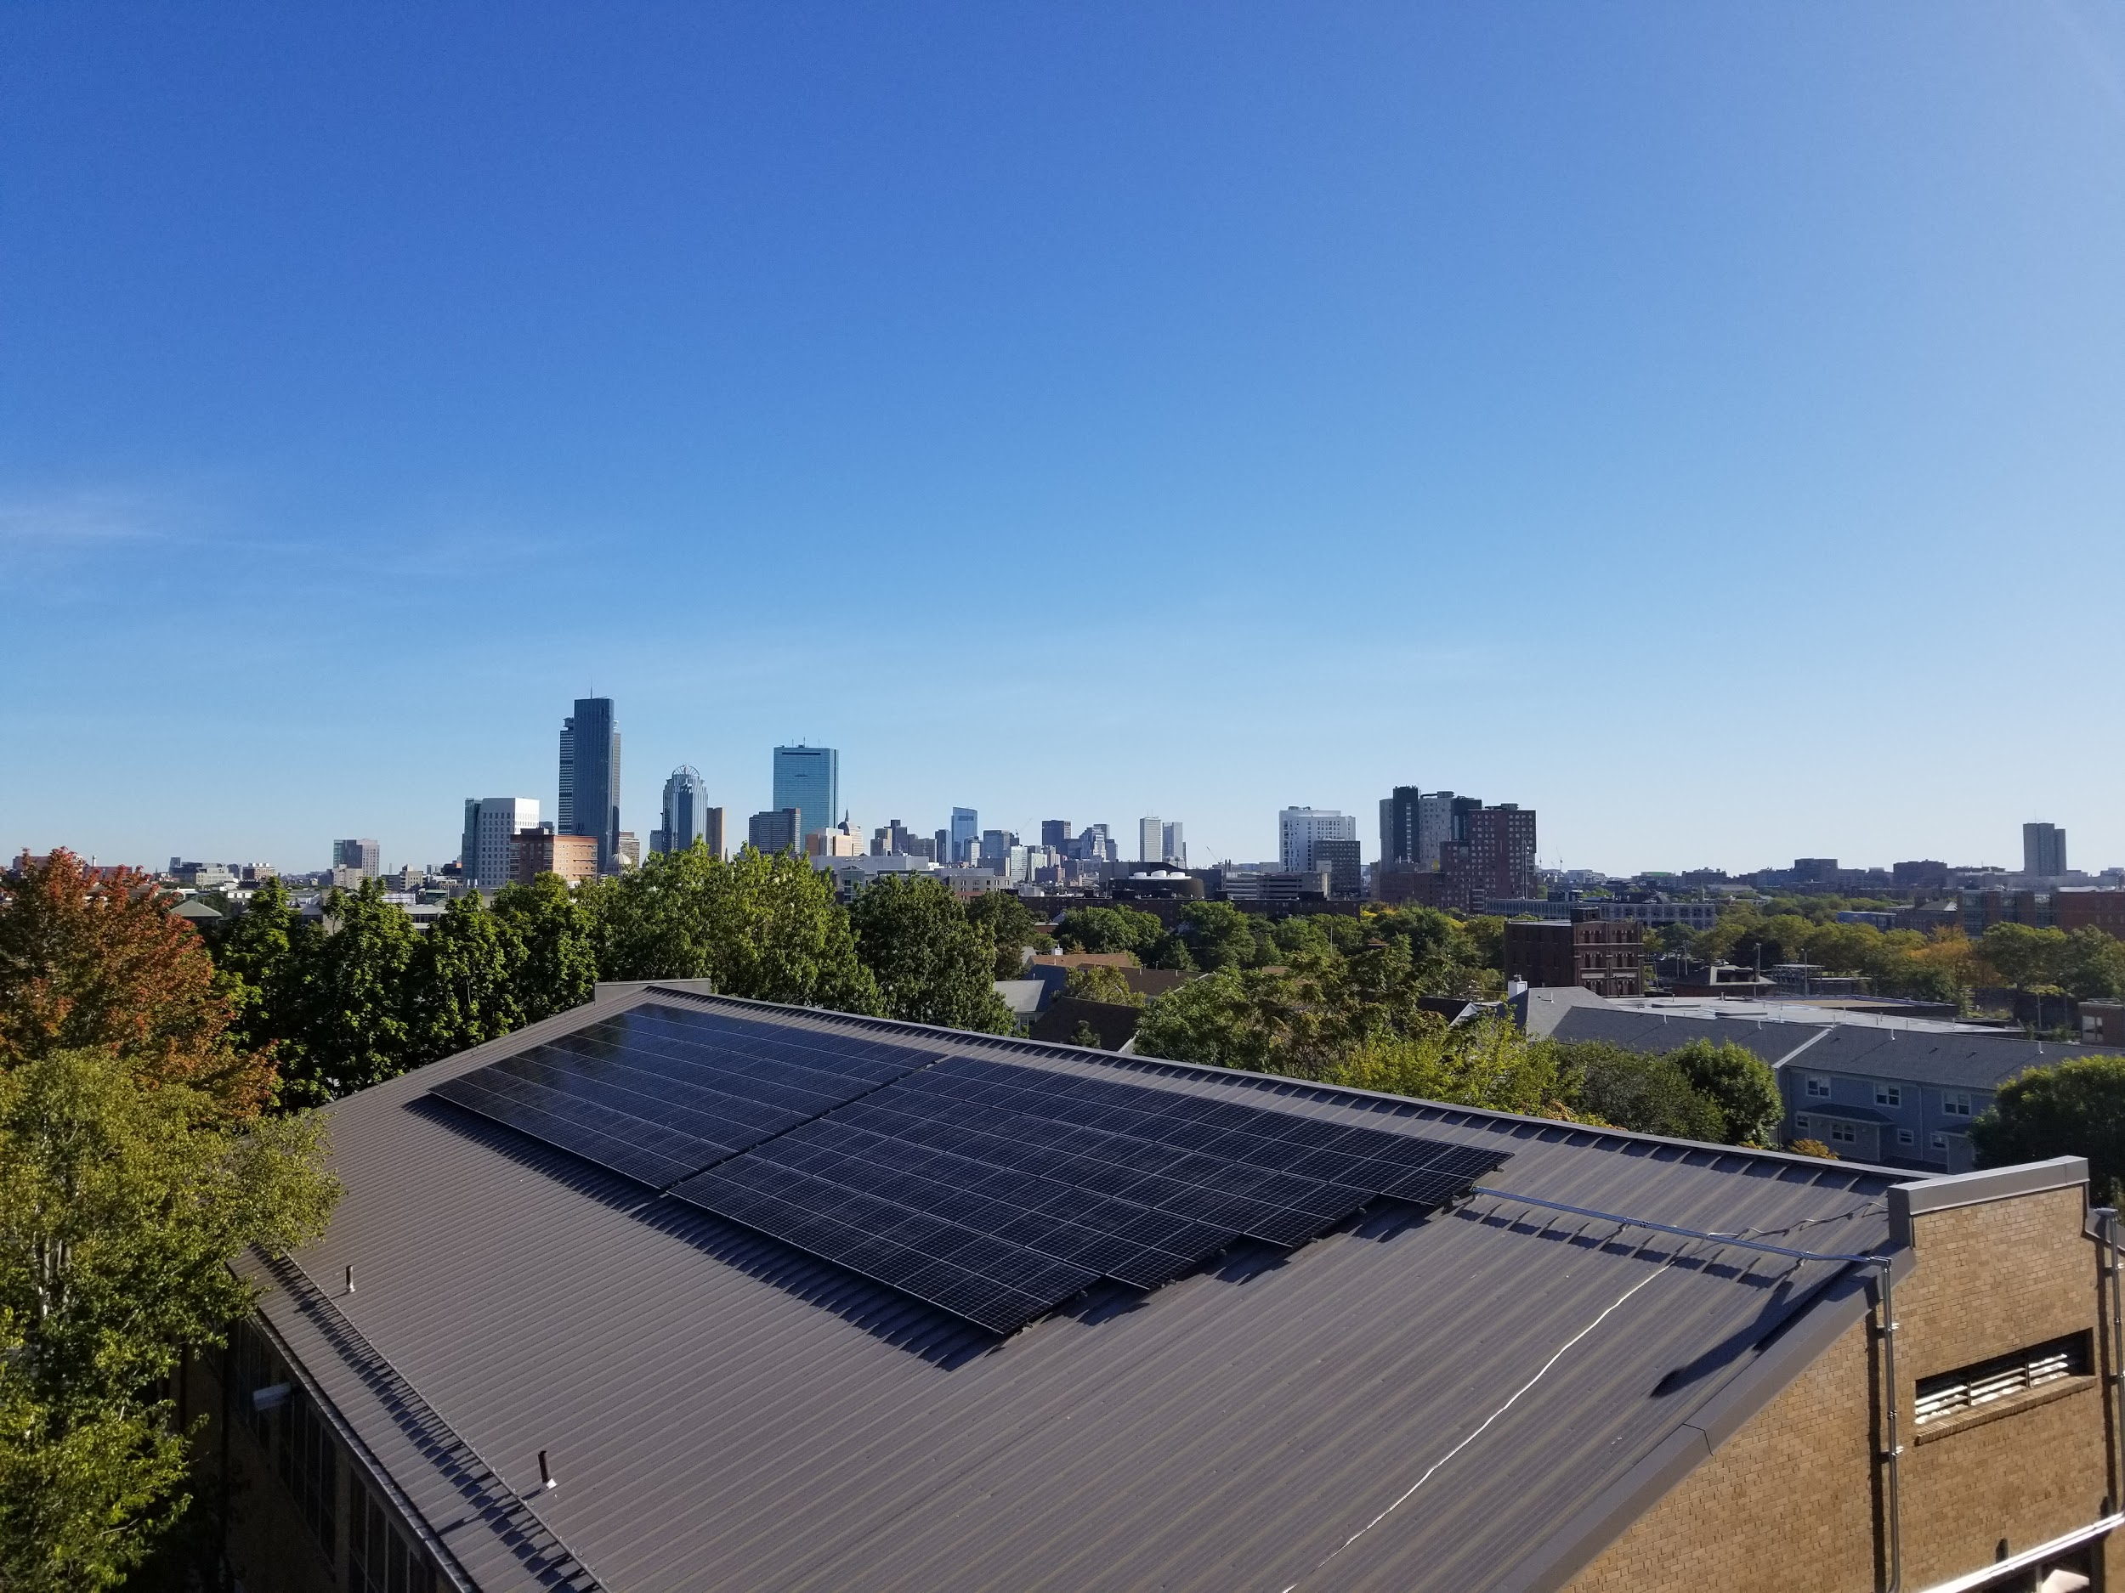
Thank You
Notes:
Tobin Community Center

Slide 19
SUPPLEMENTAL

Slide 20
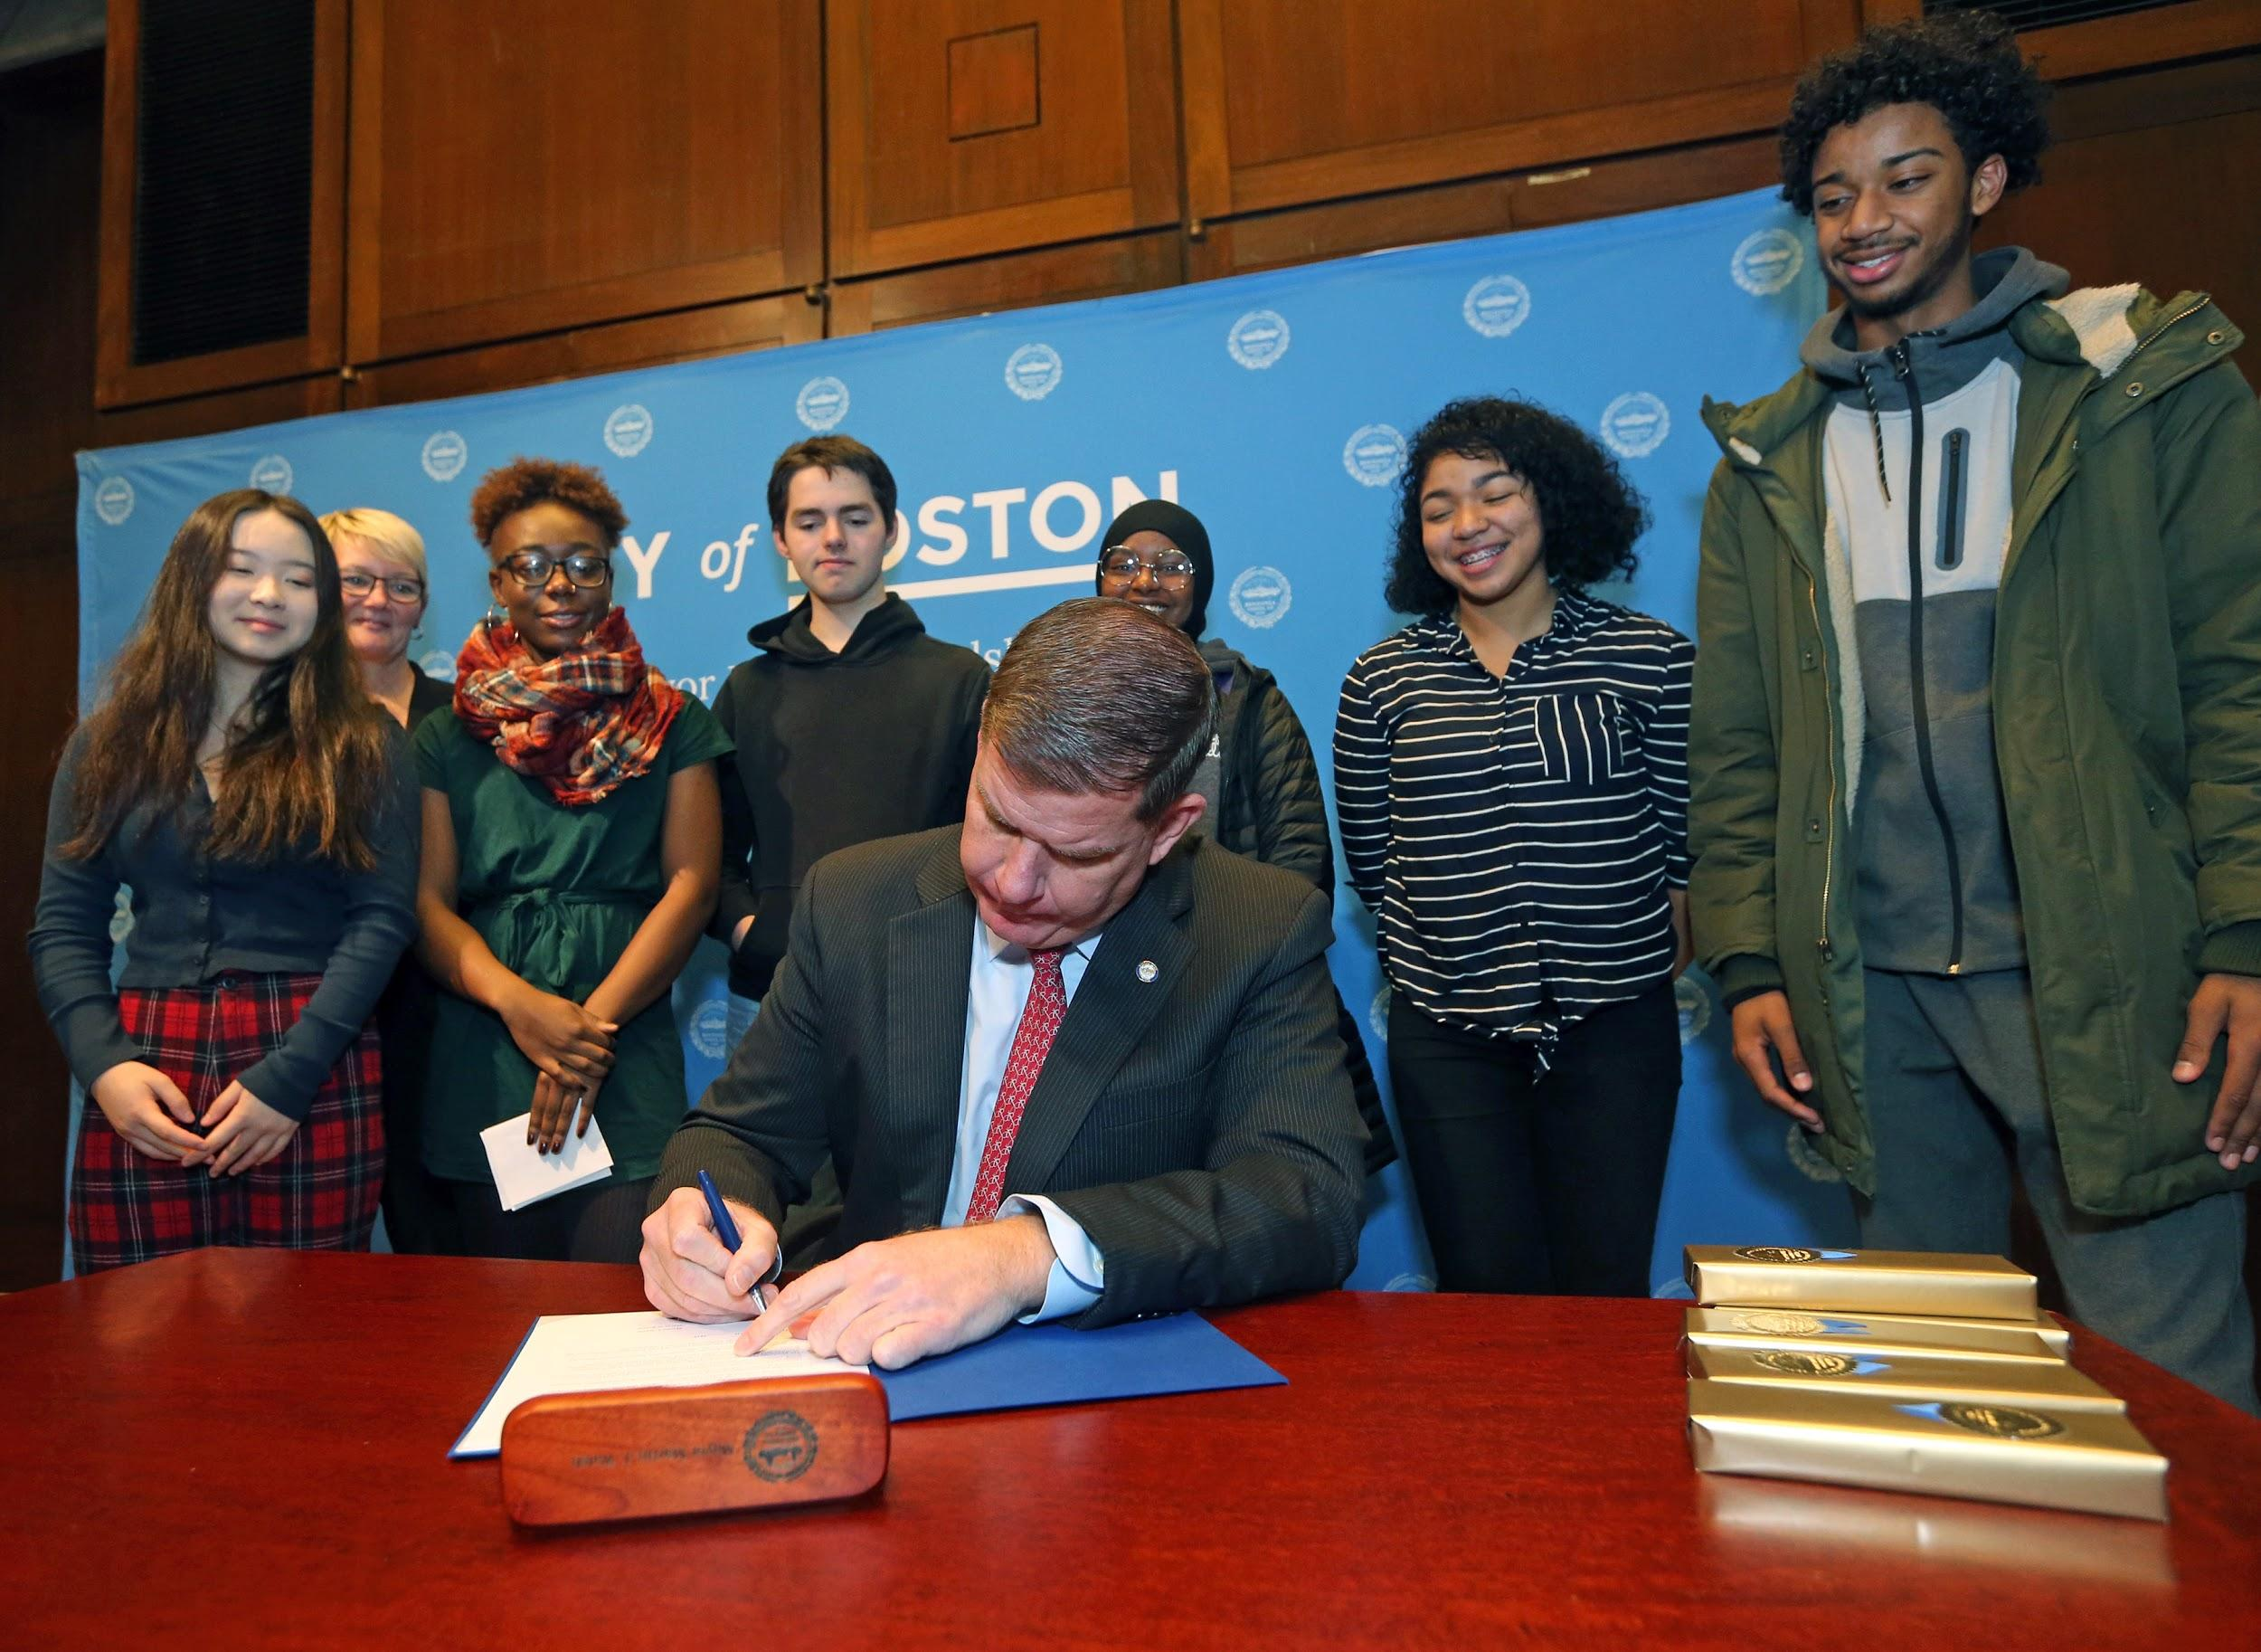


Slide 21
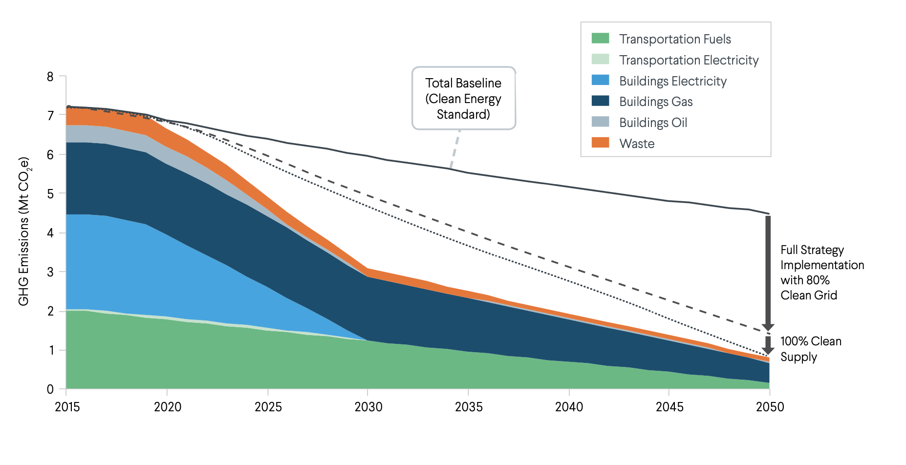
DECARBONIZATION PATHWAY

Slide 22



WHAT DOES IT TAKE TO GET TO CARBON NEUTRALITY?
Boston needs to pursue 3 strategies simultaneously:
Reduce demand for energy by increasing efficiency;
Convert nearly everything that runs on fossil fuels to run on electricity;
Buy 100% clean energy
Carbon neutrality can be achieved with the technologies of today and is essential to a healthy, thriving and resilient Boston.
Chief Cook

Slide 23
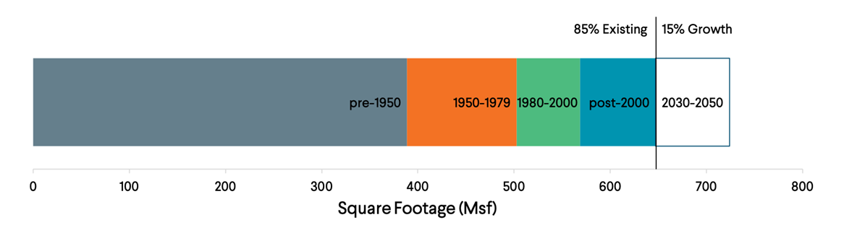
BUILDINGS
Current building stock
Boston’s building stock is old.
Any new building that is not “net-zero” is a future retrofit.
Nearly 86,000 existing buildings will need a retrofit.
2018 -2050
½ of existing floor space was built before 1950.
85% of floor space that will exist in 2050 has already been built.
Photo by Emmanuel Huybrechts (CC-BY-SA 2.0)
Chief Cook

Slide 24
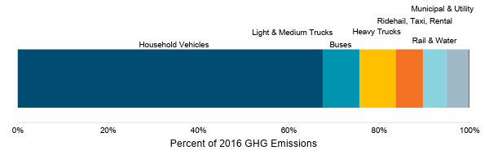
Transportation-related emissions
Current emissions
Personal vehicles drive GHG emissions: 65% of Boston’s transportation emissions come from personal vehicles.
Chief Cook
Notes:
In the transportation sector, Carbon Free analyzed emissions from Boston’s transportation system.
They found that 65% of Boston’s transportation emissions come from personal vehicles - cars and SUVs.

Slide 25
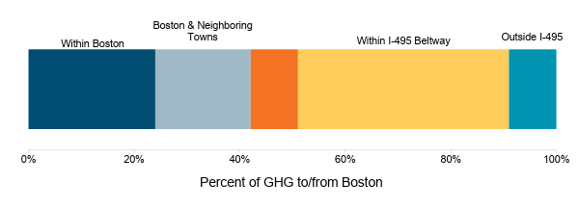
Transportation is a regional challenge
Current emissions
Long trips drive GHG emissions: ¾ of transportation emissions come from travel to and from the metro area.
Within I-95
Chief Cook
Notes:
They also found that 75% of transportation emissions come from travel to and from the metro area - basically, commuters.
This means that we need to get commuters out of gas powered cars and SUVs. It also means that public transit within Boston is not enough to reach carbon neutrality - we will need collective action at the regional level.

Slide 26
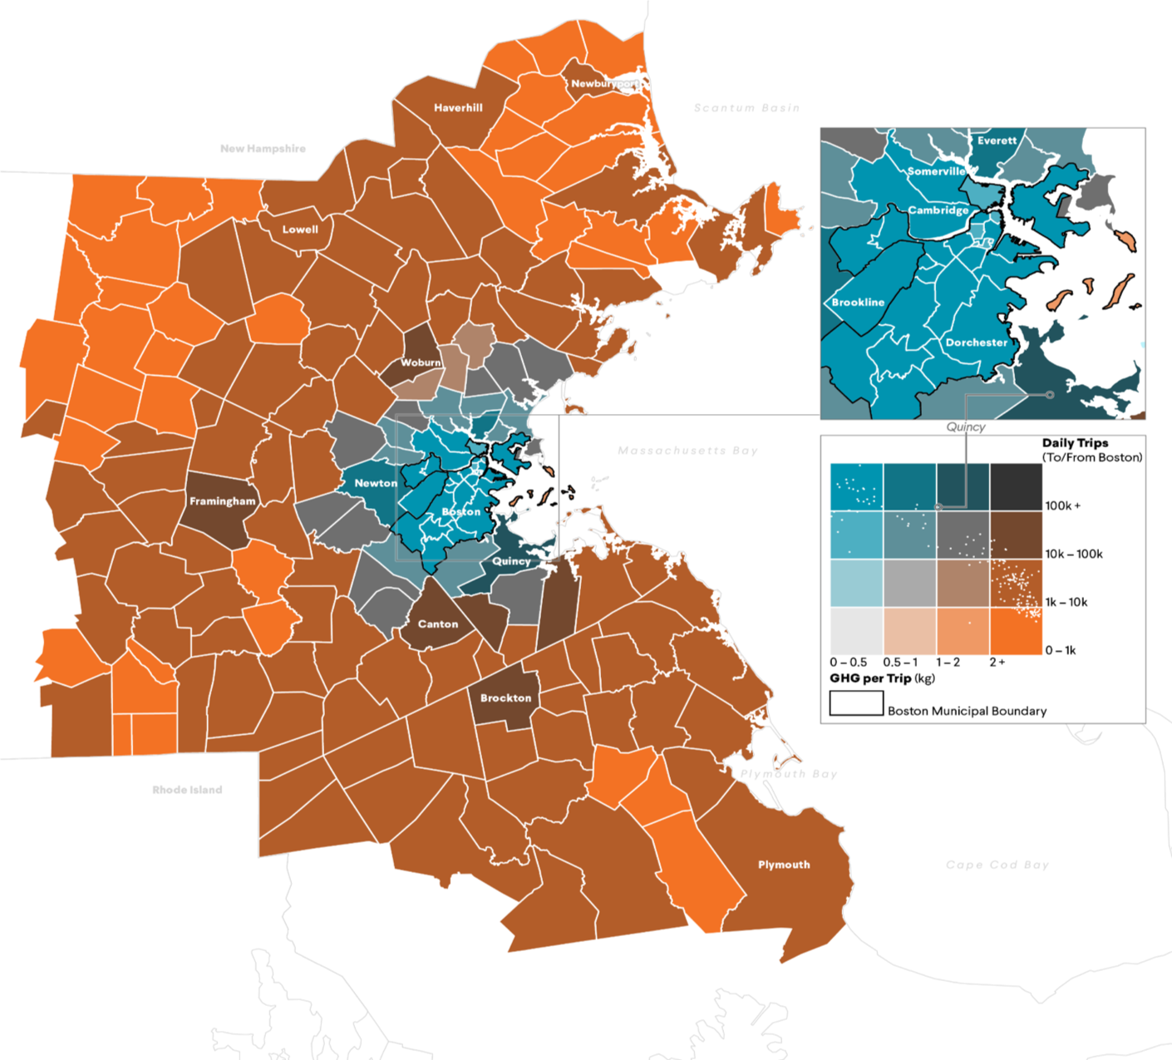
Boston Trips and GHG Emissions in 2016
People traveling between the metro area and Boston make fewer trips, but those trips emit more carbon.
People traveling around Boston proper and neighboring towns make more trips per day, and trips emit less carbon.
Note: 2017 ACS 1-year estimates indicate that ~61% of Bostonians use public transit, bike, walk, carpool, or work from home

Slide 27
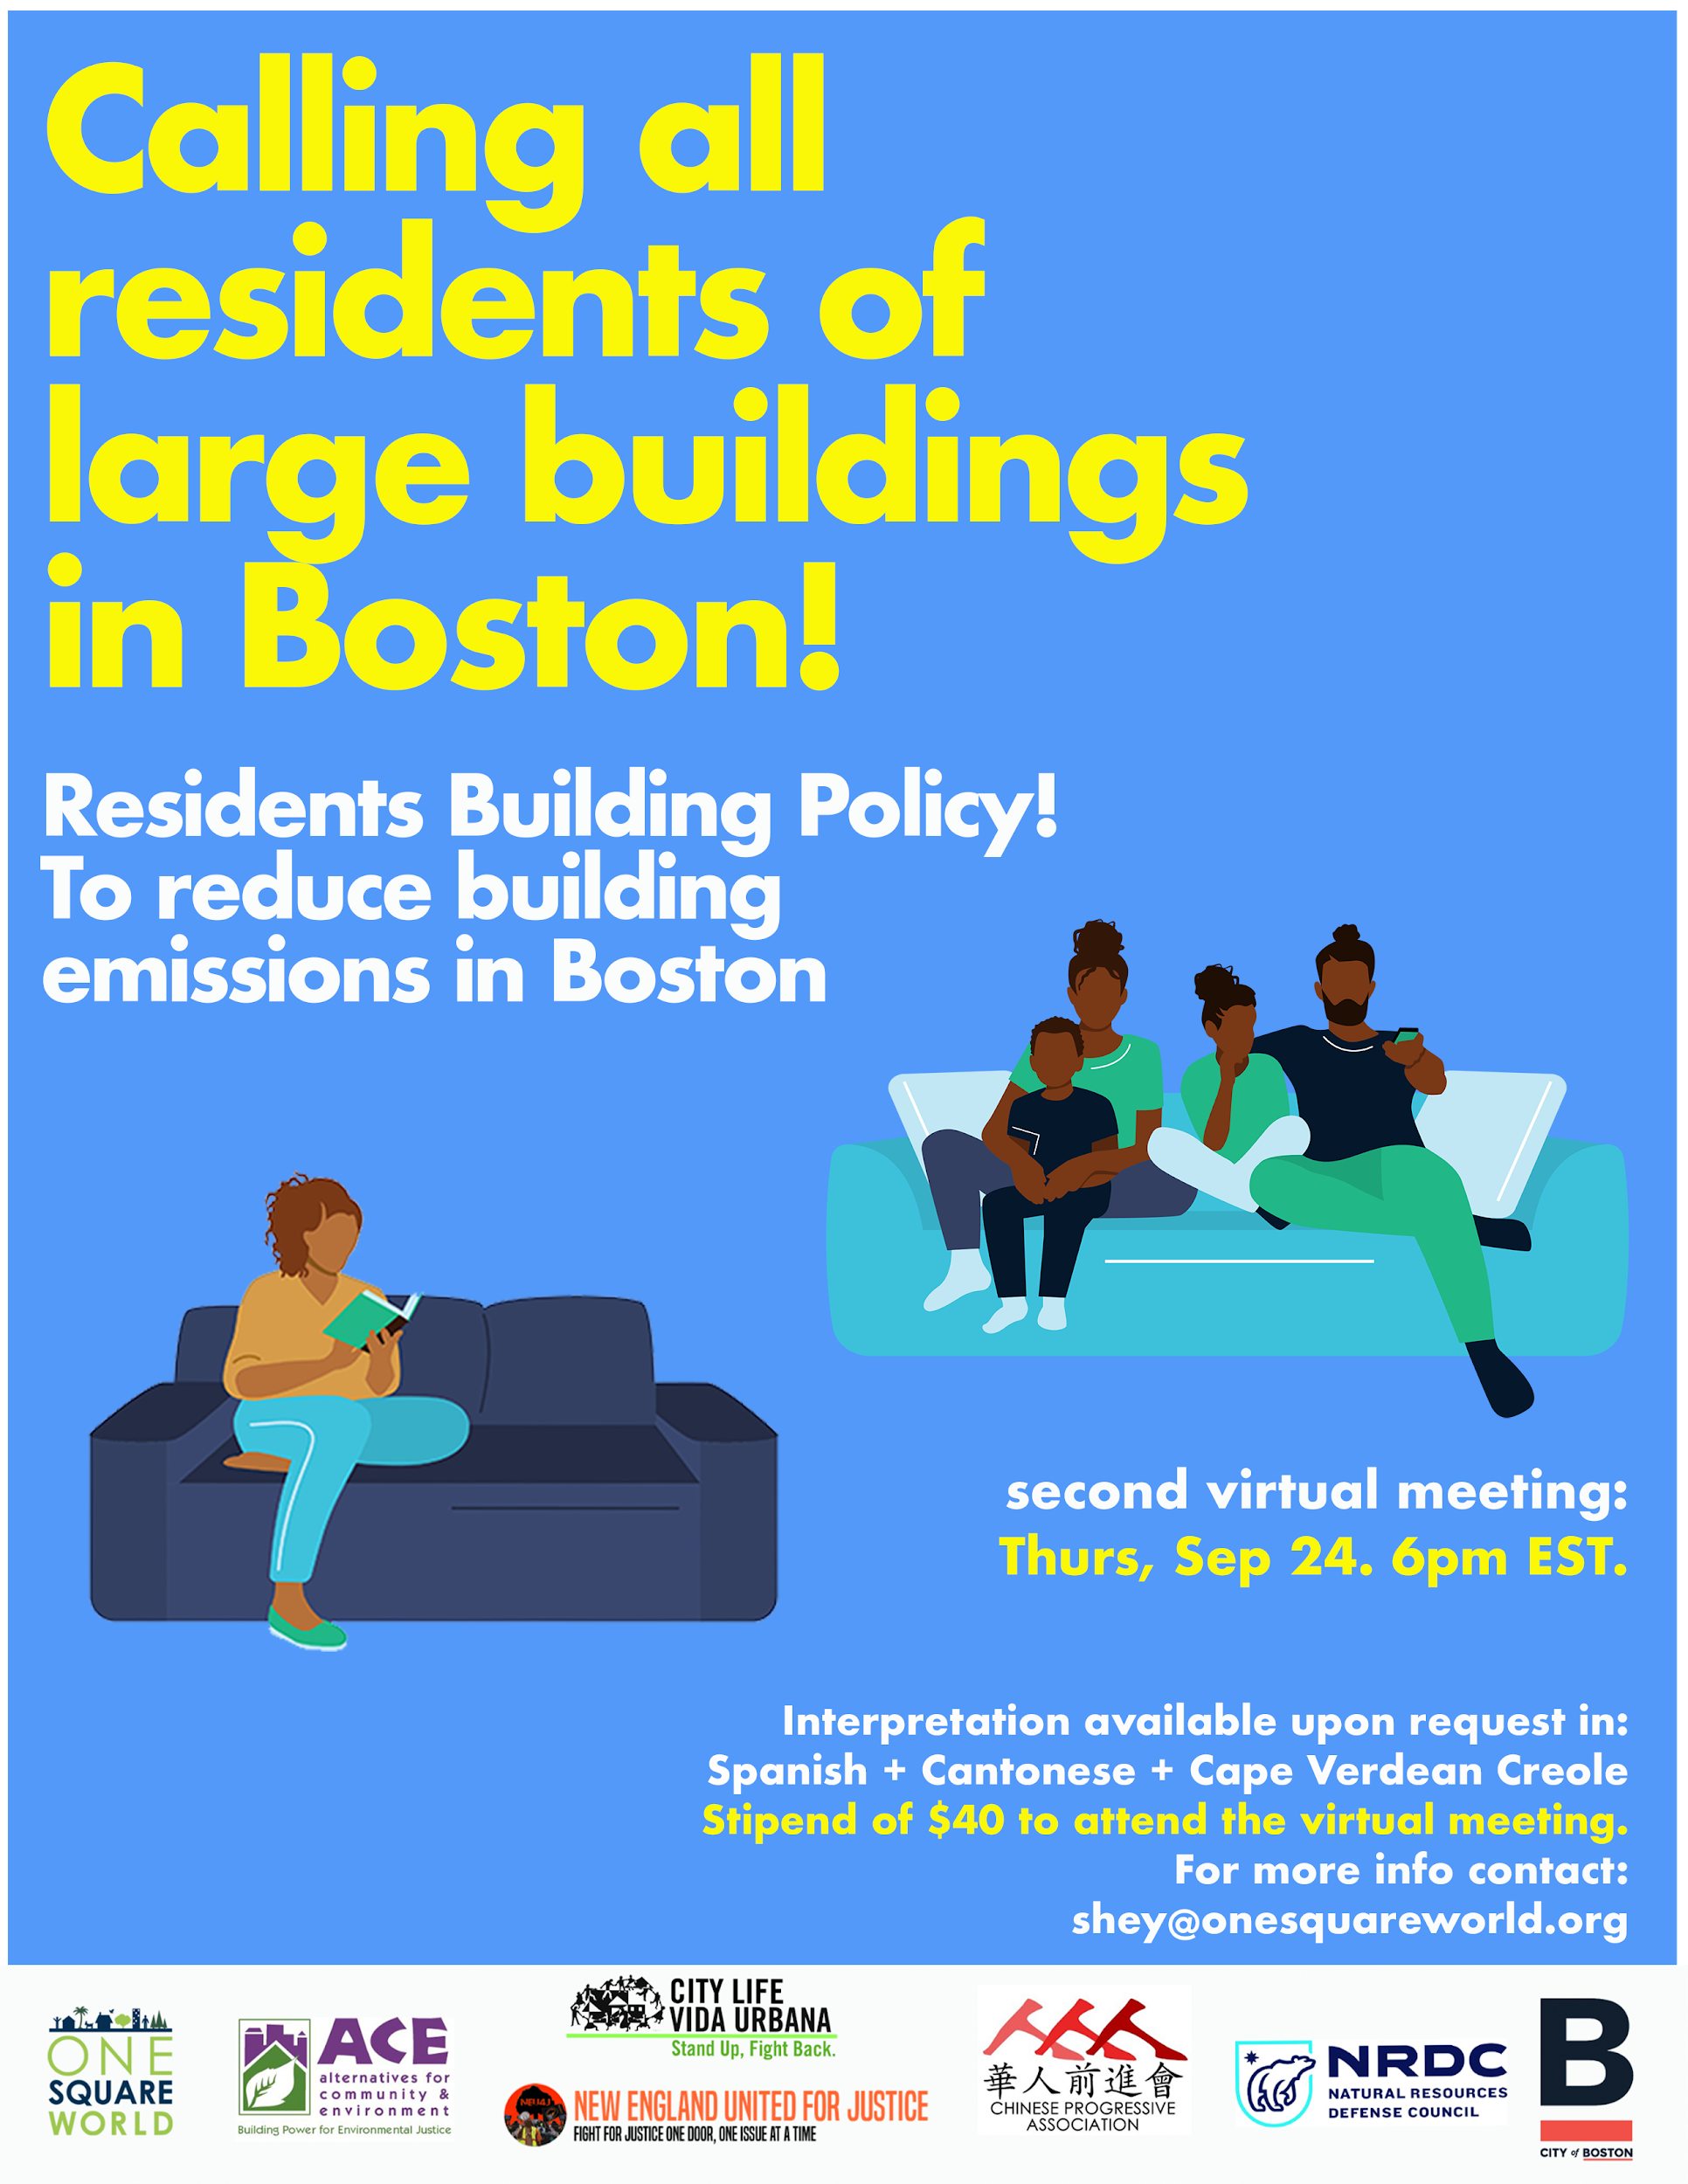


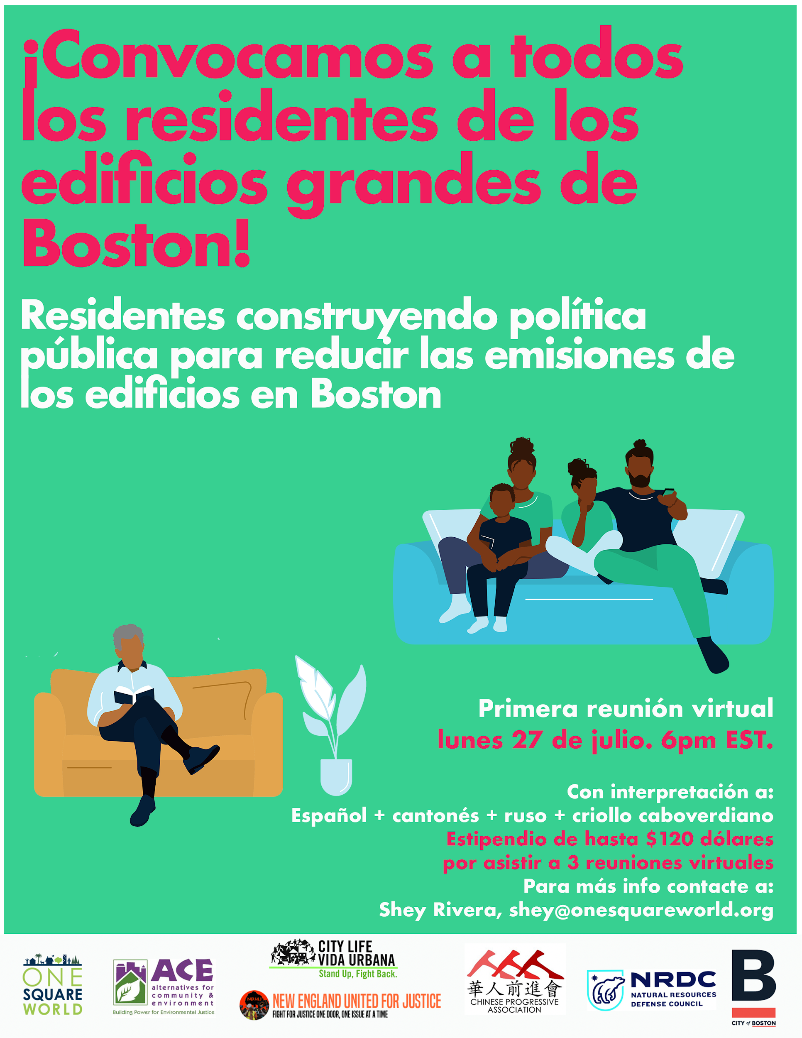
Chief Cook
Notes:
Equity in the performance standard -- working on an actual image of the group, but not sure that we have one.

